Slide 1
Singapore Energy Profile
By Kristina Ghahramanyan

Slide 2
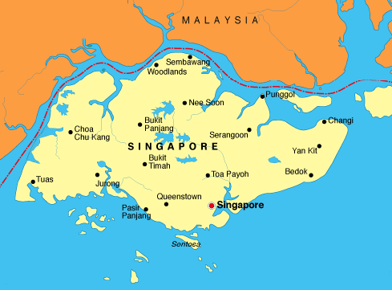
Country Profile
2
In 2019, the total population of Singapore was approximately 5.7 million inhabitants.
The Gross Domestic Product (GDP) in Singapore was worth 372.06 billion US dollars in 2019, according to official data from the World Bank.
Temperatures in Singapore are quite uniform, the average temperature is 28 °C.
Buses are, by far, the most common form of public transportation in Singapore, followed by the MRT(Mass Rapid Transit) and taxis, respectively.
Source: https://www.mochilerosviajeros.com/mapa-de-singapur/singapur-mapa/

Slide 3
Electricity portfolio for Singapore
Chart 2
Chart 1
The overall energy supply has been increasing with the approximately same rate from the year 2005
From the year 2015, Singapore has been consuming more than 700,000 tons of coal yearly, and the number is still increasing
Singapore began generating energy from renewable recourses in 2015, and still, the total supply accounts to less than 1%

Slide 4
Electricity consumption
In the year 2018, Singapore’s commercial and public services consumed the largest amount of electricity with a share of around 55.1 percent, followed closely by industrial-related sectors.
In the same year, the amount of electricity consumed in Singapore reached about 50.5 thousand gigawatt hours. Singapore consumes a large amount of electricity to power the city's infrastructure and economy.
To better meet the demands of Singaporean consumers, in April 2018, the government launched the Open Electricity Market. This allowed households and businesses to decide from which retailer and at what price they wanted to buy their electricity.
Chart 3

Slide 5
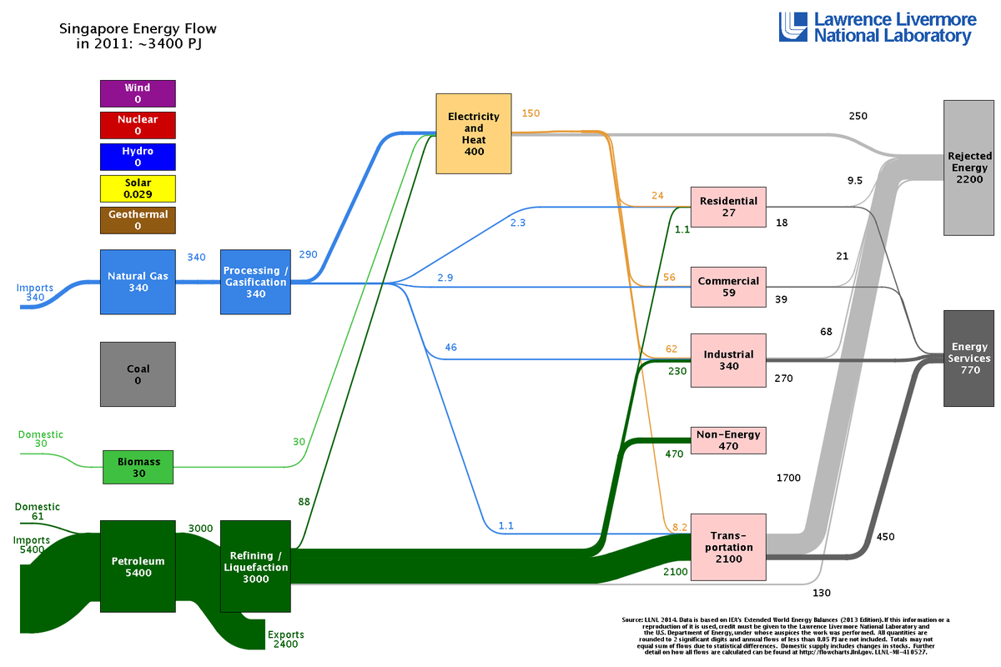
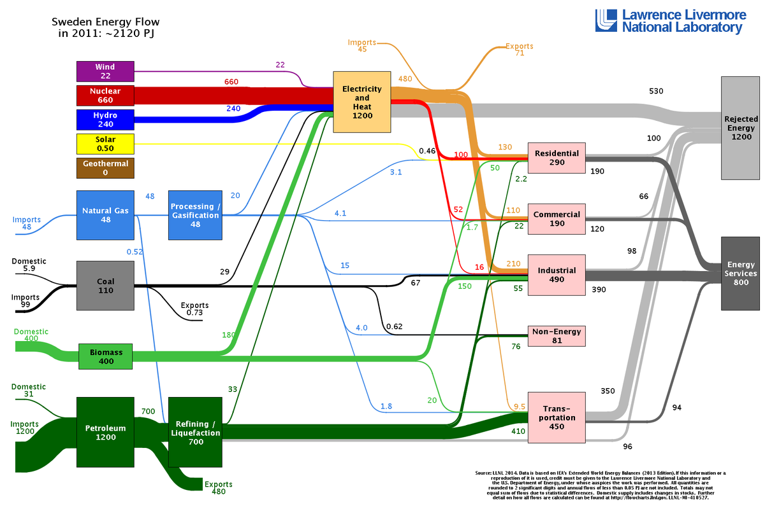
Energy Flow charts for 2011 (in petajoules)
Chart 4
Chart 5
From chart 4, we can see that more than 75% of the rejected energy of Singapore comes from the transportation sector. In comparison, during the same year, almost the half of Sweden’s rejected energy came from the generation of electricity and heat.
However, the percentage of rejected energy from transportation sector in Singapore accounts to 80%, while in Sweden it is 77%.

Slide 6
Chart 6
Singapore only generates about 0.24% of its total energy through renewable sources, due to various challenges in their installation and initiation.
Commercial wind turbines operate at wind speeds of around above 4.5m/s(meters per second) but the average wind speed in Singapore is only about 2m/s
Singapore’s relatively narrow tidal range and calm seas limit opportunities for commercial tidal power generation.
Hydroelectric power cannot be harnessed, as Singapore does not have a river system with fast flowing water throughout the year
Also, there are no geothermal energy sources in Singapore
Because Singapore is limited in terms of cost-effective and reliable renewable energy sources, solar photovoltaic is the only renewable energy source with potential to make an impact on the energy grid.
However, the installation of solar panels in Singapore is also problematic due to the limitations in the availability of land.
With the limited renewable energy options available to Singapore and the current technological capabilities, the country is not able to generate sufficient baseload electricity from renewable sources. Nevertheless, Singapore aims to deploy at least 2 gigawatt-peak of solar energy by 2030. This is equivalent to powering about 350,000 households for a year.
Chart 7
* Low-carbon energy is defined as the sum of renewable sources. Renewable sources include wind and solar. Traditional biofuels are not included.

Slide 7
Chart 8
Currently, 95% of Singapore’s electricity is produced using natural gas, while the rest is produced by coal, oil, municipal waste, and solar.
Singapore’s government has promoted the use of natural gas over the past several years, which is evident from the chart above. Singapore’s natural gas consumption increased from 230 billion cubic feet in 2005 to 400 billion cubic feet in 2015. Over the same period, the share of natural gas in Singapore’s electricity generation fuel mix increased significantly from 74% to 95% as many gas-fired generators have replaced the use of oil-fired ones.
Singapore’s government intends to rely exclusively on liquefied natural gas (LNG) imports by 2024, following the expiration of several gas pipeline import contracts.

Slide 8
Energy imports/export
Chart 9
Chart 10
Singapore is an exporter and importer of various petroleum products. More specifically, the country imports fuel oils (IFO*, HFO**, etc.) and exports diesel oil and gasoline.
Singapore is one of the world's largest refining and petrochemical complexes, the world's largest bunkering port, Asia's largest oil trading hub and two of the world's largest rig builders. Hence, the economy of Singapore is directly linked to fossil fuels.
Singapore has set out a plan to phase out internal combustion engine vehicles by the year 2040 and manufacture electric vehicles to supply the demand. The country also plans to import electricity from Southeast Asia. Also, the city-state's Carbon Pricing Act for the reduction of greenhouse gas emissions was introduced in 2019.
* Intermediate fuel oil, ** heavy fuel oil

Slide 9
9
Chart 11
The statistics from both charts show that Singapore has a highly developed economy. A higher GDP can indicate more development across a country and better social services for citizens. However, we can see that Singapore’s GDP per capita has been decreasing since 2004, yet the country is faring well in terms of education, personal safety, life expectancy, housing, and healthcare.
Singapore produces the world’s brightest young people. League tables consistently place Singapore in the top ranks. Higher than many advanced economies like Canada, Switzerland, or even Finland on some measures
The level of corruption has remained extremely low within the past two decades
The economy of this nation has been performing positively within the past decade
According to many economists, the country’s GDP per capita might surpass the $90,000 US mark by the year 2040. This is a clear indication that Singapore is on the right path towards becoming a fully developed nation
Chart 12

Slide 10
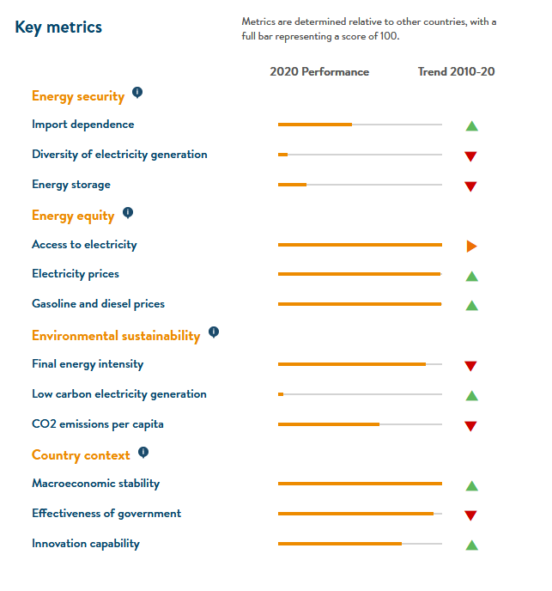
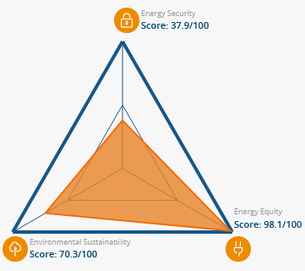
Energy Architecture Performance of Singapore
Energy Trilemma

Slide 11
References:
Charts 1, 2 retrieved from: https://www.iea.org/countries/singapore Energy topic: Energy supply. Indicator: Total energy supply (TES) by source
Chart 3 retrieved from: https://www.iea.org/countries/singapore Energy topic: Energy consumption. Indicator: Electricity final consumption by sector
Charts 4, 5 retrieved from: https://flowcharts.llnl.gov/commodities/energy
Chart 6 retrieved from: https://ourworldindata.org/grapher/low-carbon-share-energy?tab=chart&country=~SGP
Chart 7 retrieved from: https://www.iea.org/countries/singapore) Energy topic: Renewables and waste. Indicator: Renewable electricity generation by source (non-combustible)
Chart 8 retrieved from: https://www.ema.gov.sg/singapore-energy-statistics/Ch02/index2
Charts 9, 10 retrieved from: https://www.ema.gov.sg/singapore-energy-statistics/Ch01/index1
Chart 11 retrieved from: https://data.worldbank.org/indicator/EG.USE.PCAP.KG.OE?locations=SG-SE-MY
Chart 12 retrieved from: https://ourworldindata.org/grapher/energy-intensity?tab=chart&country=~SGP

